Slide 1
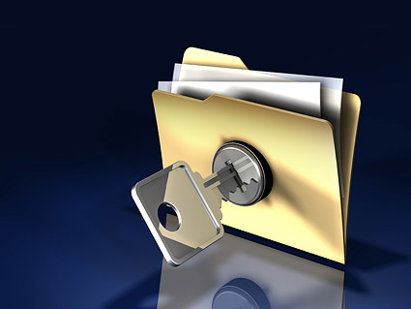
PROTECTION OF DATA

Slide 2
PHYSICAL BARRIERS
Real world protection such as locks on doors, CCTV cameras and turning computers off at night.

Slide 3
PASSWORD CONTROL OF ACCESS
Using strong passwords that are at least eight characters long and include at least on uppercase letter, lowercase letter, number and symbol.

Slide 4
ACCESS LEVELS
Ensuring people only have access to the parts of the system they need and training them before giving them greater access.

Slide 5
ANTI-VIRUS SOFTWARE
Software that deletes or quarantines viruses.

Slide 6
FIREWALL
Software that monitors data coming in and out of a network and protects it from viruses, malware and hackers. It puts a ‘wall’ around a network.

Slide 7
ENCRYPTION
Turning data into a secret code before sending it over a network or the internet, so that if it is intercepted it will not be understood.

Slide 8
BACK UP AND RECOVERY
Making a copy of data in a different place to the original data in case the original becomes corrupt or is accidentally deleted.

Slide 9
RECOVERY
Replacing the data if something happens, such as deletion or corruption. This may include copying the files from the backup to their original location or using software recovery tools.
In servers, this may involve replacing a damaged drive with a new one already loaded with the backup data.

Slide 10
PERSONAL SAFETY
Security settings can be used on social networking sites to protect users’ privacy and reputation.
This is important as not everyone is who they claim to be. Also, you might not want your teacher or colleague to see something that is embarrassing or harmful to your reputation.

Slide 11
IDENTITY THEFT
Identity theft is where someone uses another individual’s personal details to pretend they are them
They may set up accounts, access bank accounts or make purchases.
This threat can be prevented most effectively by users keeping their personal details private including on social networking sites.

Slide 12
Model Question 1
Explain two measures you can take to protect your e-reputation. (4 marks)
HINT:
The question is worth four marks – you need to give a detailed explanation of data protection measures to get full marks.

Slide 13
Model Answer 1
Any two of the following:
Computer viruses are malicious programs which replicate and can damage or steal data. Anti-virus software can be used to scan for infected files and delete the virus or quarantine the infected files.
Phishing emails are a threat because they pretend to be from a legitimate sender and try to trick you into clicking a link or revealing your personal details. To protect against phishing emails, users should use good practice and common sense and be alter for indicators of a fake email.

Slide 14
Model Answer 1
Any two of the following:
Hackers are people who try to access areas of a network without authorisation. A firewall can protect against hackers because it monitors data going in and out of a network and can prevent hackers from gaining access.
An opportunist threat might be a person who finds an unattended computer that has been logged into a system, and they decide to use it to access unauthorised data. This could be prevented with physical security such as locks on the doors, CCTV and ensuring computers are locked or logged off when not in use.

