Slide 1

THREATS TO DATA

Slide 2
There are risks to the security of data or equipment.

Slide 3
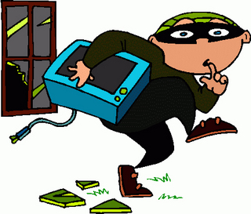
OPPORTUNITY THREATS
Threats from people who see an opportunity, such as an unattended computer.

Slide 4
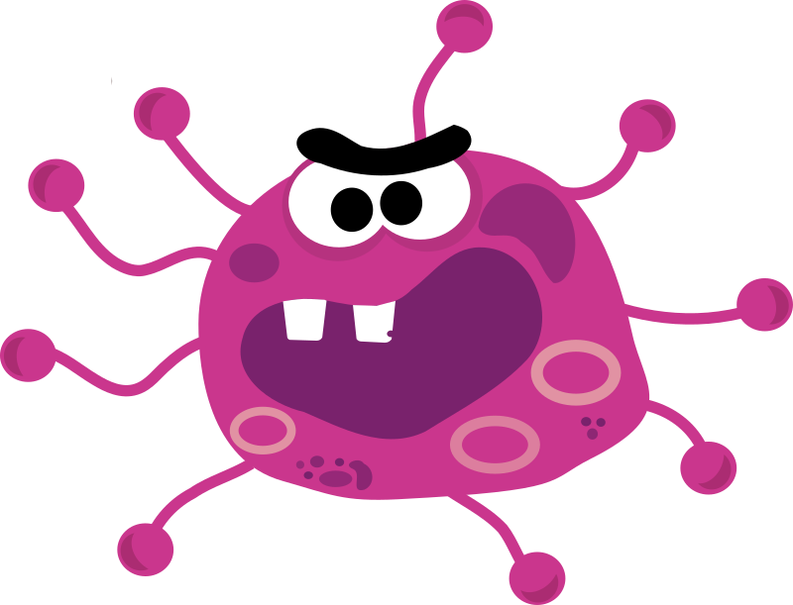
COMPUTER VIRUSES
Malicious programs that try to replicate and spread across a computer or a network.

Slide 5
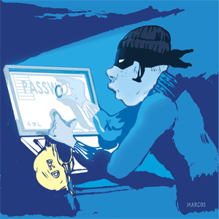
OTHER MALWARE
This includes Trojans, worms, adware, spyware and other nasty software that is aiming to cause damage or steal data.

Slide 6
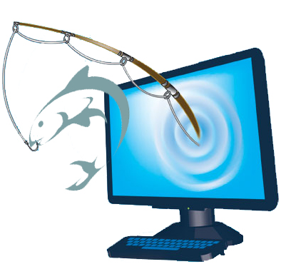
PHISHING
A fake email or website that is trying to trick the user into handing over their personal data.

Slide 7

ACCIDENTAL DAMAGE
This could include floods, fire or hurricanes, or damage from untrained users.

Slide 8

HACKERS
People who purposefully try to gain unauthorised access.

Slide 9
Model Question 1
Complete this text to show why security is important. (3 marks)
A business does not have adequate security:
There is a risk that information might be stolen. This information is known as ………………………………
Competitors may use this to create their own inferior version of the product.
This could lead to mistrust
This may damage the company’s ……….…….
Ultimately this would lead to loss of ………………

Slide 10
Model Answer 1
A business does not have adequate security:
There is a risk that information might be stolen. This information is known as  intellectual property
Competitors may use this to create their own inferior version of the product.
This could lead to mistrust
This may damage the company’s  reputation
Ultimately this would lead to loss of  profits

Slide 11
Model Question 2
Describe two threats which can affect a business’ data. (4 marks)
HINT:
Describe means you have to name the threats and explain what they are.

Slide 12
Model Answer 2
 One threat which can affect a business could be a computer virus, which is a malicious program that can damage or steal data.
 A second threat could accidental damage, which could include floods and fires.

