Slide 1
SERVER SIDE PROCESSING

Slide 2
Server-side processing uses the web server to process web page data.
Server-side processing is where the interactivity on a web page is processed on the web server.
The code which makes this possible is a scripting language (web scripts).

Slide 3
Web scripts are included in the code of the web page and run when the page is loaded into the user’s browser. In server-side processing it does not matter which browser the user is using because the processing is done on the web server.
An example is a form completed online which is filled in by the user then submitted to the server where the results are processed and stored.

Slide 4
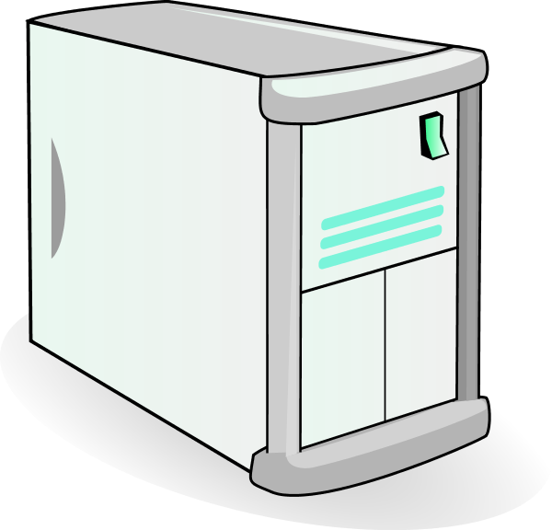

HOW WEB PAGES WORK
4) Data is processed on web server
2) User fills in form
1) Copy of website is downloaded
3) Data is sent back for processing
WEB SERVER
CLIENT

Slide 5

Server-side Processing
Advantages
 Efficiency – the information to
process does not need to be downloaded to the client’s computer.
Browser independent – doesn’t matter which
browser the user has as the work is done separately on the server.
Speed – the processing occurs on
The web server, which is likely to be more powerful than a client’s computer

Slide 6
Server-side Processing
Disadvantages
Security – when data is transferred
across the internet it is more at risk of
security threats.
 Overloading – if a lot of users are asking the web server to process data, it could overload the server and cause it to run slowly or crash

Slide 7
Model Question 1
Identify which of these statements are about client-side processing and which are about server-side processing. (3 marks)
Processing happens on the user’s device
Client Server
Processing happens on the web server
Client Server
The web page appears the same no matter what browser the user is using
Client Server

Slide 8
Model Answer 1
Processing happens on the user’s device
Client Server
Processing happens on the web server
Client Server
The web page appears the same no matter what browser the user is using
Client Server







Slide 9
Model Question 2
Identify which of these statements are about client-side processing and which are about server-side processing. (3 marks)
There is less chance of interference by hackers as data is not moving across the internet.
Client Server
The processor may run slowly if too many users are accessing it at the same time.
Client Server
The web page is downloaded before it is processed
Client Server

Slide 10
Model Answer 2
Identify which of these statements are about client-side processing and which are about server-side processing. (3 marks)
There is less chance of interference by hackers as data is not moving across the internet.
Client Server
The processor may run slowly if too many users are accessing it at the same time.
Client Server
The web page is downloaded before it is processed
Client Server







Slide 11
Model Question 3
Explain what server-side processing is. (2 marks)

Slide 12
Model Answer 3
 Server-side processing is where the processing of a web page occurs on the web server rather than the client’s machine.
It is created using web scripts. An example is a web form that has been filled in and submitted for processing.

Slide 13
Quick Quiz - Question 4
Describe the benefits and the disadvantages of server-side processing. (4 marks)

Slide 14
Model Answer - Question 4
One benefit is efficiency , because it is processed on the server rather than needing to download it onto the client.
Another benefit is that it is browser independent, because it doesn’t matter what browser the user is using as it occurs on the web server.
One disadvantage is security, because moving data over a network puts it at risk from hackers
Another disadvantage is overloading, because if too many demands are put on the server it may run slowly or crash.

