Slide 1
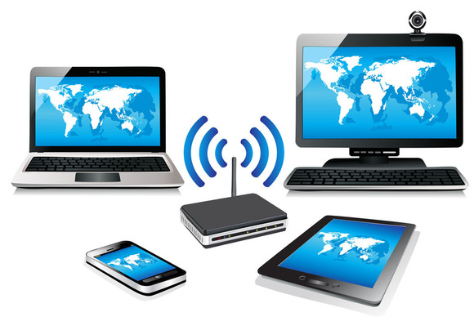
WIRELESS
TRANSMISSION METHODS

Slide 2
Wireless transmission methods do not use cables. Data is transmitted through the air using electromagnetic waves.

Slide 3
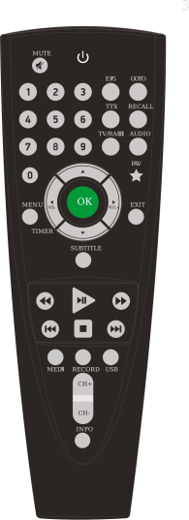
INFRARED
Uses infrared light to transfer data (invisible to the human eye)
Example of use – TV remote, keyboard and mouse connecting to computer
 Reliable
 Short range
 Devices must be in line of sight
 Can suffer from interference

Slide 4

MIRCOWAVE
Uses short wavelengths to transmit data (invisible to the human eye)
Example of use – Bluetooth
 Good for longer distances (but still need devices fairly close)
 Can suffer from interference from other devices

Slide 5

SATELLITE
Uses satellites in space to relay data between different points on Earth
Example of use – Global communication services
 Good for very long distances
 Very expensive

Slide 6

WIRELESS NETWORKING
Devices using wireless networking will need a wireless network interface card (NIC) which will allow it to receive wireless signals.
These are built into devices such as tablets, laptops, smartphones etc.
The NIC connects to the Network Access Point (NAP) this could be home or anywhere e.g., McDonalds, Bus, Train

Slide 7
Model Question 1
Explain one advantage of connecting to the internet wirelessly. (2 marks)
HINT:
It is very important that you say “where there is an internet connection” otherwise it is an unrealistic answer!

Slide 8
Model Answer 1
Wireless networking means that the user can connect a device to the internet anywhere where there is an internet connection

Slide 9
Model Question 2
A small business has used Bluetooth to connect computers to one printer in the office. Identify which two of these issues might cause problems. (2 marks)
The printer is a long way from the computer
The printer is being used by many users at the same time
The printer is near a kitchenette where there is a kettle and microwave
The printer’s NIC is at the back of the device
The printed is plugged into a socket next to a computer
HINT:
Remember choose TWO options

Slide 10
Model Answer 2
The printer is a long way from the computer (distance too long)
The printer is near a kitchenette where there is a kettle and microwave (interference)

