Slide 1
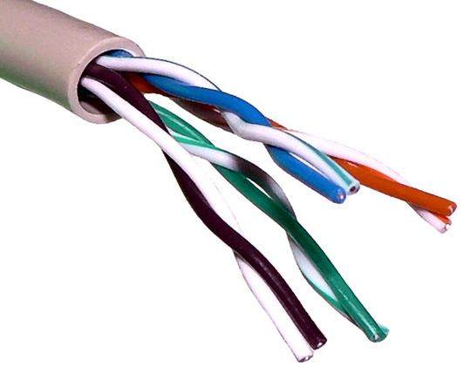
WIRED
TRANSMISSION METHODS

Slide 2
Some devices are connected with wires.
There are three transmission methods you need to know about:

Slide 3
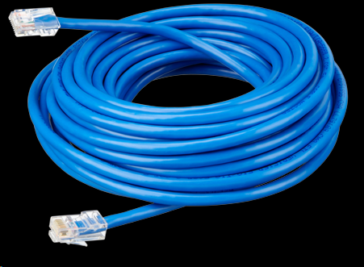
UTP/STP
Unshielded twisted pair (UTP)
is cable made up of pairs of copper wires twisted together.
Shielded cable (STP) has a protective layer around the copper wires (under the plastic coating) to protect the data from interference.
Example of use – Connecting computers to a network backbone

Slide 4
UTP/STP
 Interference is lessened due to the twisting
Cheaper than other methods
Reliable
 Slow
 Low capacity
 Used over short distances
 Susceptible to noise, which means the data can be interfered with if near another digital device or signal

Slide 5
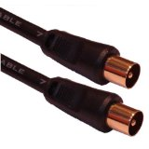
COAXIAL
Solid copper wire with thick shielding.
Example of use – Connecting a TV to an aerial
 Reliable
Slow
Low capacity
Used over short distances
Thick and physically inflexible
Susceptible to noise

Slide 6
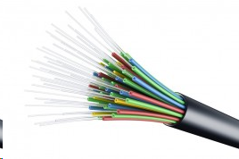
FIBRE OPTIC
Glass or plastic cables which use light to transmit data.
Example of use – Backbone of a network
Fast
Used over long distance
Little interference
Expensive
Complex to install (needs a specialist)

Slide 7
Model Question 1
A school has used STP to connect computers in their classroom to a network.
Give two reasons why they have chosen this type of cable. (2 marks)
HINT:
It is easier to make sure you have given TWO reasons if you number your answers.

Slide 8
Model Answer 1
It is cheap
It is reliable

Slide 9
Model Question 2
Match the cable type with its description. (2 marks)
Fibre Optic slow, low capacity
UTP fast expensive
Coaxial cheap
HINT:
In the online test you would have to click on the cable type then a description to join them with a line

Slide 10
Model Answer 2
Fibre Optic slow, low capacity
UTP fast expensive
Coaxial cheap

