Slide 1

DATA EXCHANGE
TRANSMISSION MODES

Slide 2
Transmission modes are ways in which devices on a network communicate with each other and transmit data.

Slide 3
There are three types of transmission mode.
send
receive
a) SIMPLEX
send
receive
receive
send
B) FULL-DUPLEX
(Bi-directional because the signals travel in both directions)
send
receive
receive
send
C) HALF-DUPLEX

Slide 4
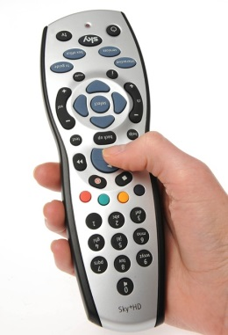
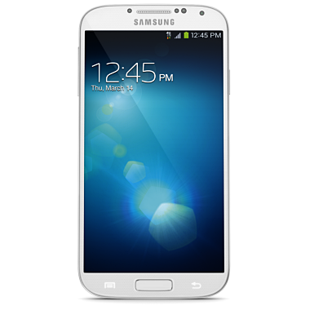
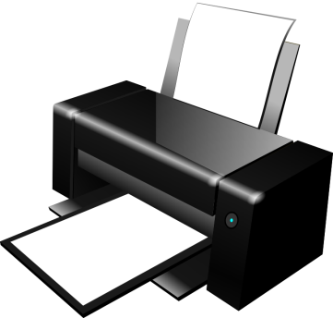
Transmission modes are used by digital devices such as those shown below
SIMPLEX
signals go in one direction at a time
FULL-DUPLEX
Signals go in both directions at the same time
HALF-DUPLEX
signals go in both directions but don’t transmit at the same time

Slide 5
CHARACTERISTICS OF DATA TRANSMISSION
Transmission Mode | Data Transfer | Benefit | Limitation
Serial | Bits of data are transferred one at a time over a wire | Good over large distances | Complex because data has to be broken into individual bits
Parallel | Bits of data are transferred simultaneously over a wire – a whole byte can be transferred at the same time | Faster because more bits are transferred per second | Shorter distance maximum about 5 metres

Slide 6
Model Question 1
Parallel transmission is much faster than serial transmission because: (1 mark)
  It transfers one bit at a time
It can be used over large distances
  It transfers several bits at the same time
It is good over shorter distances

Slide 7
Model Answer 1
   It transfers several bits at the same time

Slide 8
Model Question 2
Choose a transmission mode for the devices below and explain your choice. The first one has been done for you. (4 marks)
Device | Transmission Mode | Explanation
Control system on a production line | Half-Duplex | Signals go in both directions to monitor and send instructions. They do not need to go at the same time
Mouse connecting to a computer
Smartphone synching to a computer

Slide 9
Model Answer 2
Device | Transmission Mode | Explanation
Control system on a production line | Half-Duplex | Signals go in both directions to monitor and send instructions. They do not need to go at the same time
Mouse connecting to a computer |  Simplex |  Signals go in one direction at a time
Smartphone synching to a computer |  Full-Duplex |  Signals go in both directions at the same time

