Slide 1

SEARCH ENGINES

Slide 2
Search engines are websites which allow users to find data on the internet.
Examples include google.com and bing.com

Slide 3

The user enters
Keywords into the search engine
The search engine searches its indexed database of web pages on the internet
The results are displayed in order of popularity with sponsored links at the top
All the time, web spiders are moving around the internet looking for new webpages. When they find it, they log it in an indexed database.

Slide 4
Another name for WEB SPIDERS is WEB CRAWLERS.
These are small automated programs (bots)
Done automatically so humans not needed

Slide 5
Remember SPONSORED LINKS are companies that pay to appear at the top.
The more they pay the higher up they appear.
More on this in ADVERTISING.

Slide 6
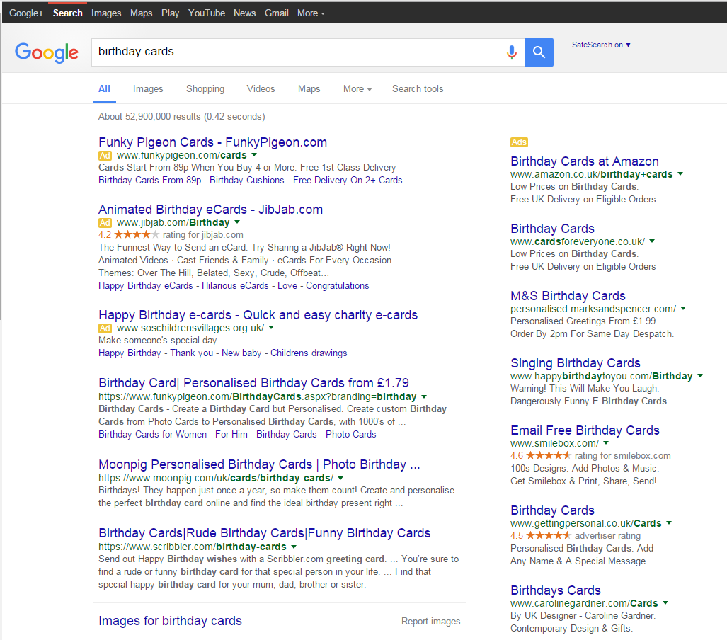
Model Question 1
Describe three different types of results in this image. (3 marks)

Slide 7
Model Answer 1
  Sponsored links, which have been paid for, are listed first in the results. Adverts are down the right hand side and are chosen based on the search key words. The rest of the results are listed in order of popularity.

Slide 8
Model Question 2
Explain how a search engine works. (2 marks)
HINT: Make sure you are clear that web spiders search the internet ALL THE TIME. Do NOT say that they search after the user enters key words

Slide 9
Model Answer 2
  The user types key words into the search engine. All the time web crawlers are searching the internet for new or updated web pages and adding what they find into the search engine’s database. The database is searched for the user’s keywords. The results are displayed in order of popularity with sponsored links at the top.

