Slide 1

WORLD WIDE WEB

Slide 2
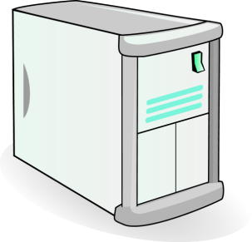

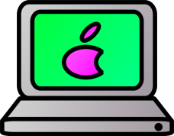
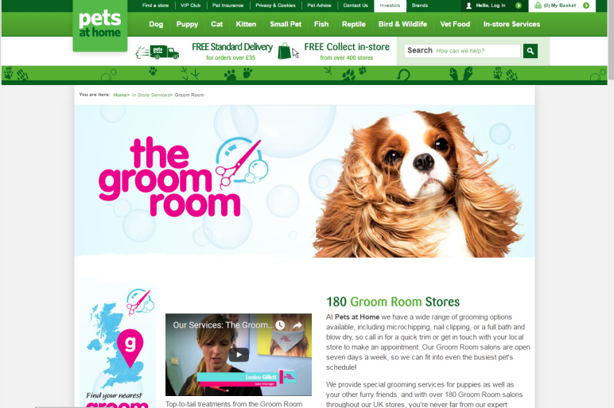
Internet
WEB SERVER
CLIENT
ORIGINAL WEB PAGE
COPY OF WEB PAGE

Slide 3
HYPERLINKS
The World Wide Web works because of hyperlinks. They connect web pages together.
When a hyperlink is clicked, a user is taken to another page on a website or a different website.

Slide 4
WEB SERVERS
Websites are stored on web servers.
When a user accesses a website through a web browser it is temporarily downloaded onto their computer.
It is the web server’s job to deliver the web page requested.

Slide 5




BROWSERS
Web pages are accessed through web browsers. These are applications which allow a user to enter a URL and view a web page.

Slide 6
Model Question 1
Describe what a hyperlink is and what it does. (2 marks)

Slide 7
Model Answer 1
A hyperlink is a text or an image on a web page that can be clicked and then takes the user to another page or file. It allows web pages to be connected together and is the element that creates the World Wide Web.

Slide 8
Model Question 2
Explain how a user requests a web page and how it then appears on a user’s screen. (2 marks)
HINT: If a question is asking you to ‘explain’, make sure that you expand your answer to include all the necessary information.

Slide 9
Model Answer 2
The user requests a web page by using its web address (URL). A copy is downloaded from the web server onto the client’s computer. It is displayed using a web browser.

