Slide 1

CONNECTION
METHODS

Slide 2
There are three methods for connection to the internet.
Availability of each may depend on location.

Slide 3
1. WIRELESS
Connects without using wires.
 Not fixed to a stationary computer.
 Can be used wherever wireless internet is available.
 Needs to have wireless internet available.
 Can be less secure than wired.

Slide 4



Internet
WIRELESS ACCESS POINT

Slide 5
2. BROADBAND
A wired connection through a broadband supplier.
 Better reception and faster than dial-up.
 Wired so has to be used on a stationary computer.

Slide 6
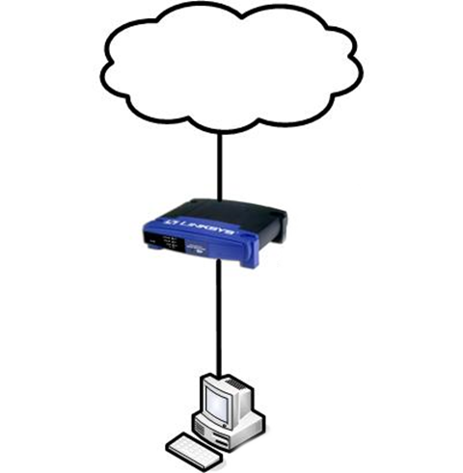
Internet
Modem
Computer

Slide 7
3. DIAL-UP
A wired connection using a modem and telephone lines.
 Can use existing telephone lines, giving connection where broadband is not available.
 Older technology can give poor reception.
 Conversion between analogue signals can cause errors.
 Usually slower than other methods.

Slide 8
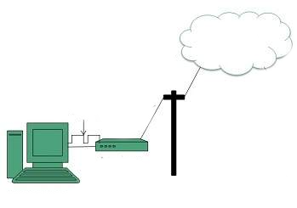

Internet
Phone Line
Modem
Computer

Slide 9
BANDWIDTH
Bandwidth is how the speed of section of the internet is measured. It describes how much capacity (space) there is to carry data.
Bandwidth is measured in bits per second – the number of bits of data that can be transmitted is one second.
High bandwidth means more information can be moved during that time, therefore giving faster internet connection and a higher transmission rate.

Slide 10
Model Question 1
Describe the effect low bandwidth would have on the running of a website and why this might be. (2 marks)

Slide 11
Model Answer 1
Low bandwidth would make the website run slowly. This is because less data can move through the cables (less bits per second), therefore the data is moving more slowly.

Slide 12
Model Question 2
Choose the best internet connection for each of these people from the options below. (2 Marks)
Types of internet connection:
Broadband
Wireless
Dial-up
HINT: Remember that broadband is not available in many rural areas
Rosie lives in an isolated farmhouse
Paulo lives in a city apartment
Rachel lives on the outskirts of the city and travels to work on the train everyday, working while she travels

Slide 13
Model Answer 2
Rosie lives in an isolated farmhouse | Dial-up
Paulo lives in a city apartment | Broadband
Rachel lives on the outskirts of the city and travels to work on the train everyday, working while she travels | Wireless

