Slide 1
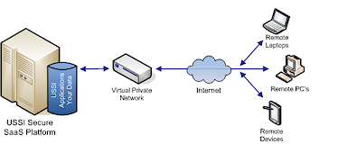
THE INTERNET
NETWORK DIAGRAMS

Slide 2
Network diagrams show how pieces of technology connect together

Slide 3






ISP
Internet
SERVER
This network diagram shows how the key pieces of technology connect together to allow clients to access the internet.
BACKBONE
ROUTER
CLIENT
CLIENT
CLIENT

Slide 4
POP
Point of Presence (PoP) is an access point to the internet.
An ISP may have several PoPs to allow good access to the internet.

Slide 5
NAP
Network Access Point (NAP) is where different networks interconnect, such as your home network onto the internet.

Slide 6

Model Question 1
This network diagram shows the access points involved in connecting the client so they can access the internet
Correctly place the terms PoP, NAP and Internet in the diagram. (3 marks)

Slide 7
Model Answer 1
Internet
NAP
PoP

Slide 8
Model Question 2
Complete this diagram. (2 marks)
Client
ISP
Internet

Slide 9
Model Answer 2
Client
ISP
Internet

