Slide 1
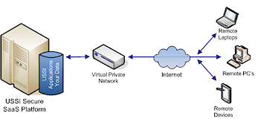
THE INTERNET
HARDWARE

Slide 2
The internet is a global network of interconnected computers.
It allows data to be exchanged between computers and devices

Slide 3
What is the difference between the internet and the world wide web?
The internet is the technology (the hardware).
The World Wide Web is the content, the web pages, the data.

Slide 4
INTERNET HARDWARE

Slide 5
SERVER
Runs special software to serve other computers.
Types: file servers, print servers, web servers, email servers.

Slide 6
CLIENT
A computer/device that uses services provided by a server.
The computer/device you use to access the internet is a client.

Slide 7
ROUTERS
Devices which ‘route’ (direct) traffic (data) through a network.
They are intelligent and will try to find the best routes.

Slide 8
CONNECTIONS/CABLES
The connections between this hardware.
Cables, fibre, telephone lines, etc.

Slide 9
BACKBONE
A ‘big’ cable (often fibre) which connects a large number of devices

Slide 10
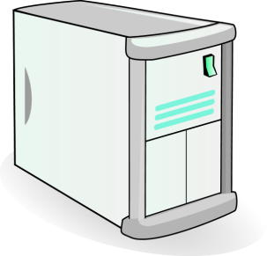
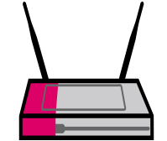
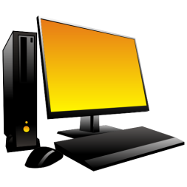
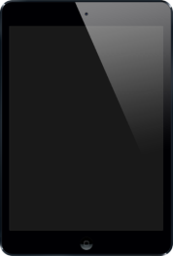
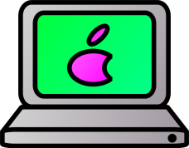
SERVER
Powerful computer that controls the network
BACKBONE
ROUTER
Device which directs traffic over a network
CLIENT
CLIENT
CLIENT

Slide 11
INTERNET SERVICE PROVIDER (ISP)
An ISP allows connection to the internet for a client. It would be too expensive to connect directly to the internet so the ISP gives an easy way for connection.
An ISP may provide connection to one client or a network of clients, for example a home network. ISPs can also provide additional services such as website development and technical support – this is usually for an additional fee.

Slide 12

Model Question 1
Match the correct hardware to the definition. (3 marks)
Client
Server
Router
Powerful computer that controls the network
Device which directs traffic over a network
A user’s device such as a laptop or smartphone
HINT:
In your online test you can flag a question for review so you can come back to it later.

Slide 13
Model Answer 1
Server | Powerful computer that controls the network.
Router | Device which directs traffic over a network.
Client | A user’s device such as a laptop or smartphone.

Slide 14
Model Question 2
What is the name given to the device that directs the traffic over the internet? (1 mark)
Modem
Client
Server
Router

Slide 15
Model Answer 2
Router


