Slide 1

U BI QUIT OUS
_ /_ _ /_ _ _ _ /_ _ _
UBIQUITOUS COMPUTING
(existing everywhere)

Slide 2
Ubiquitous means ‘existing everywhere’. Ubiquitous computing is where processors are embedded into everyday objects.

Slide 3


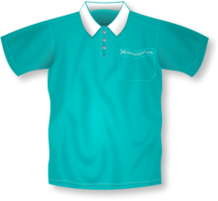
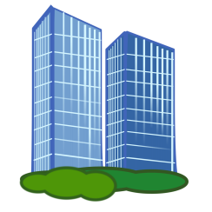
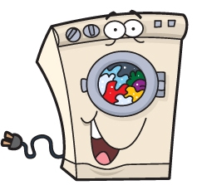


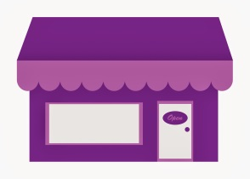
VEHICLES
FACTORIES
CLOTHING
BUILDINGS
UBIQUITOUS
COMPUTING
APPLIANCES
PEOPLE
PETS
SHOPS

Slide 4
VEHICLES
Built-in GPS/sat nav (Satellite Navigation) to direct the driver

Slide 5
FACTORIES
Processors attached to tags to count items for stock control purposes.

Slide 6
BUILDINGS
Processors in fire alarms to detect smoke, set off alarms and contact the fire brigade.

Slide 7
PEOPLE
Pacemakers fitted to regulate heartbeat

Slide 8
SHOPS
Processors in tags that are attached to clothes. They are removed when an item is purchased. If an item is stolen it will set an alarm off when the item is taken from the store.

Slide 9
PETS
Used to store information about a dog/cat in case they get lost.

Slide 10
APPLIANCES
Processors in washing machines to monitor load size, amount of water, different programmes, etc.

Slide 11
CLOTHING
Processors embedded into running kit to measure distance, heartbeat, etc. of the wearer

Slide 12
RFID CHIPS
Radio Frequency Identification chips (RFID) are a way to embed processors into everyday objects.
They can be used to identify and track an object. It is similar to a bar code, although it does not need to be scanned.

Slide 13
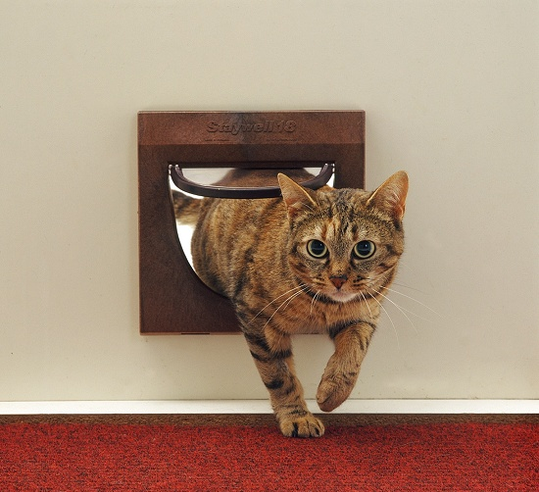
CAT FLAPS
This cat flap only opens for an animal wearing the correct RFID chip

Slide 14
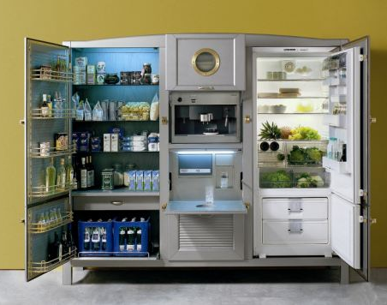
FRIDGES
This fridge uses RFID chips to monitor and order groceries

Slide 15
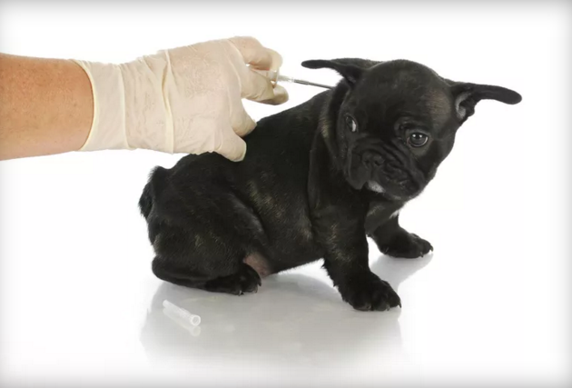
PET CHIPPING
A RFID chip (the size of a grain of rice) is inserted between the shoulder blades, this stores information about the pet in case it gets lost.

Slide 16

Model Question 1
Describe one use of RFID chips in a high street retail shop.
State one benefit their introduction could bring. (2 marks)
HINT:
Think carefully about what information the question is asking for. There are TWO parts – ONE marks for each

Slide 17
Model Answer 1
RFID chips are used for security. There will be scanners near each exit so if a person steals something and tries to take it through an exit without paying the alarms will sound. The benefits of RFID are that items do not need to be scanned like a bar code, they can be scanned just by walking through the sensors.

Slide 18
Model Question 2
Give two examples of where ubiquitous computing might be useful. (2 marks)
HINT:
Identify and explain the first example, then identify and explain the second example.

Slide 19
Model Answer 2
One example where Ubiquitous computing could be useful is in stock control where items are scanned to record how many are in a warehouse.
Another example could be where RFID chips are put into pets so they can be reunited with their owners if they are lost.

