Slide 1

CLOUD COMPUTING

Slide 2
Cloud computing is where data is saved on external servers instead of on the user’s hard drive.
The external servers are called HOSTS and are owned by a HOSTING COMPANY. Some well known examples are Dropbox™, Microsoft-One D™ and Google Cloud ™.

Slide 3
CLOUD STORAGE
Cloud users can access software, data and storage provided by their hosting company.
Users usually access the cloud through a web browser or mobile app – they do not directly access the servers.

Slide 4




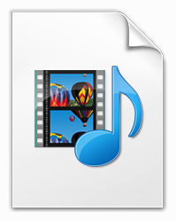
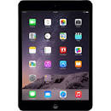
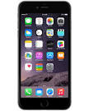
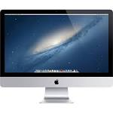
What is the cloud? Is it in the air? No it’s a physical server somewhere in the world. Here is a look at Google’s servers (this is where they store all the data that you store in the cloud)

Slide 5



CLOUD STORAGE
Benefits
COST - You only pay for the storage that you use. You do not have to provide and maintain the hardware.
AVAILABILITY - Data Can be available anywhere in the world where there is an internet connection.

Slide 6

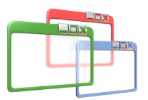

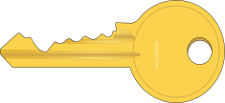
CLOUD STORAGE
Drawbacks
X
RELIABILITY - It depends on how reliable the host is to access your data
SOFTWARE - The company may not be using the latest, fastest version.
POTENTIAL PERFORMANCE – The speed of accessing data might be slower than using installed software.
SECURITY – You have no control over the files stored and you to trust the company to keep them safe
X
X
X

Slide 7
What is the cloud?
Is it in the air?
No it’s a physical server somewhere in the world.
Let’s look at:
GOOGLE’S SERVERS
MICROSOFT’S SERVERS
APPLE’s iCLOUD SERVERS

Slide 8
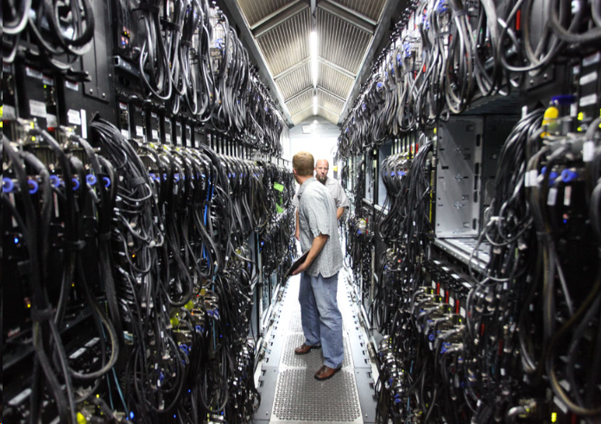
CLOUD STORAGE

Slide 9
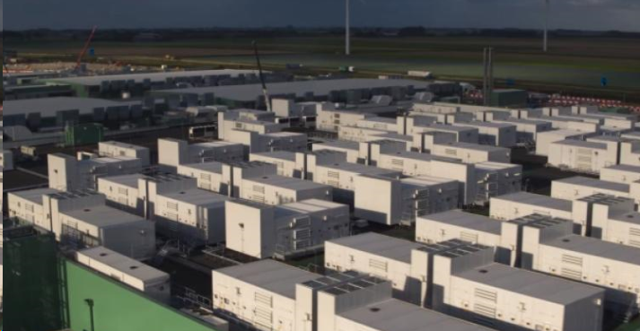
CLOUD STORAGE
Microsoft Azure

Slide 10
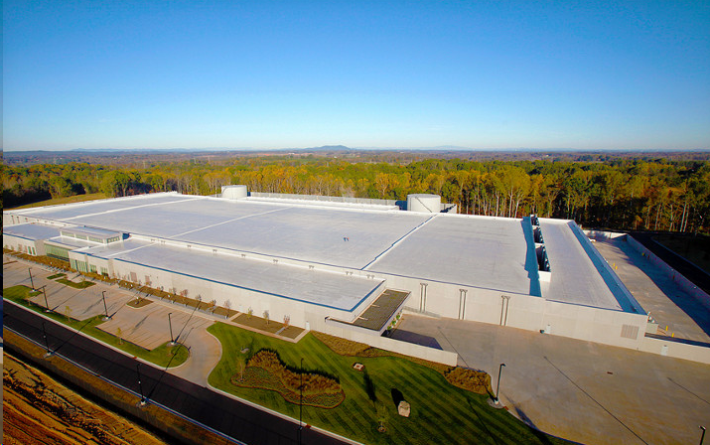
CLOUD STORAGE
Apple’s iCloud

Slide 11

Model Question 1
Explain how data is stored in cloud computing. (2 marks)
HINT:
You need to say how AND where the data is stored in each case!

Slide 12
Model Answer 1
In cloud computing, data is saved to external servers (hosts)

Slide 13
Model Question 2
Explain how data is stored in installed software. (2 marks)
HINT:
You need to say how AND where the data is stored in each case!

Slide 14
Model Answer 2
In installed software, data is saved to the computer’s hard drive

Slide 15
Model Question 3
Name two advantages of cloud computing. (2 marks)
HINT:
How many advantages are asked for? How many marks are available?

Slide 16
Model Answer 3
Cost, because you can buy a cheaper computer with smaller hard drive
Availability, because it can be accessed anywhere where there is an internet connection

