Slide 1
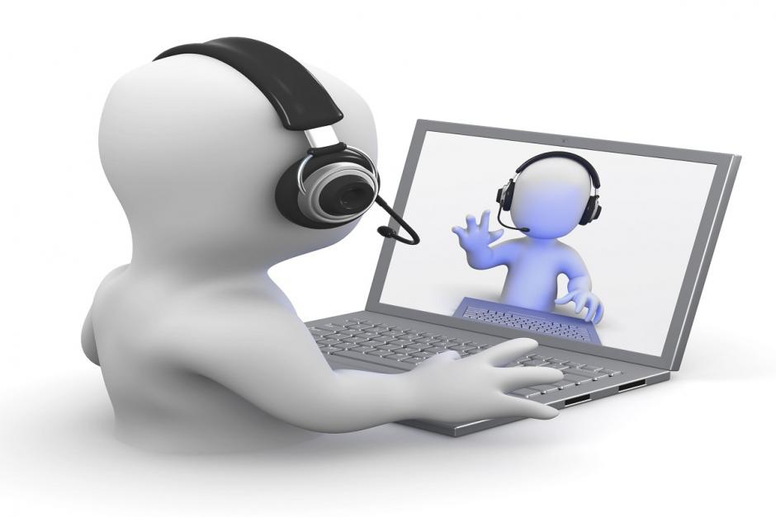
VOICE OVER INTERNET PROTOCOL
(VoIP)

Slide 2
VoIP (Voice over Internet Protocol) is a method of real-time communication over the internet, for example SKYPE ™.
The data transmitted is audio and video as two computers are connected through their unique IP addresses.

Slide 3

VoIP Advantages
Able to contact someone anywhere in the world where there is an internet connection.
Uses internet-only so no additional cost (unlike phone calls).
Reduces travel costs, travel time, etc.

Slide 4
VoIP Disadvantages
Relies on internet connection so it can be a slow connection or it can cut out.
As the audio is being converted to digital, transmitted over the internet and converted back again, the voice quality can be affected.
Data exchanged over the internet is at risk of security threats such as hackers.
X
X
X

Slide 5

Model Question 1
a) A business is working with a supplier based in another country. Why might they be reluctant to use only VoIP for the weekly meetings? Choose ONE answer from the following options. (1 mark)
It is more expensive
They need a separate venue The quality isn’t always reliable They want to be able to use video

Slide 6
Model Answer 1
The quality isn’t always reliable


Slide 7
Model Question 2
VoIP is being used by a business to allow colleagues in different branches to hold weekly meetings.
Explain two benefits to the business of using this technology. (4 marks)
HINT:
Think carefully about all the information the question is asking for!

Slide 8
Model Answer 2
VoIP can allow people who work in different countries to communicate – it can save time and money by holding meetings over VoIP instead of face to face.
It uses internet only so there is no additional costs (unlike phone calls).

