Slide 1

ONLINE COMMUNICATION

Slide 2
Communicating online includes instant messaging.
Online communication requires rules and involves users in developing a profile for their online presence.

Slide 3
NETIQUETTE
NETIQUETTE is a set of rules to which users should conform when online. It is short for net etiquette.
This would include not using capitals (as it means shouting), appreciating privacy and not making unkind comments.

Slide 4
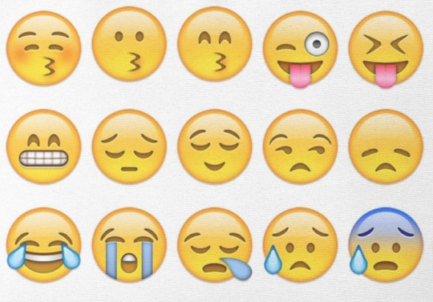
EMOTICONS
(EMOJIS)
Emoticons, also known as smilies, are images that represent emotions.
One of the most common keyboards that can be added to tablets and mobile phones is the emoji keyboard. This results in emoticons
often being referred to
as emojis.

Slide 5
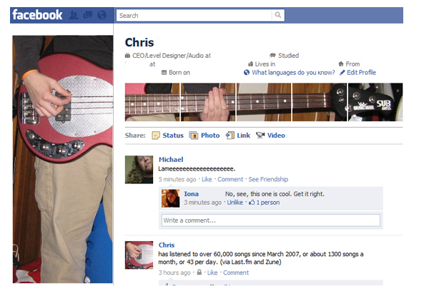
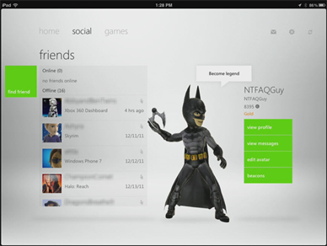
PROFILE
A PROFILE is the online presence of a user in a particular system, for example on a games system or social media website.

Slide 6

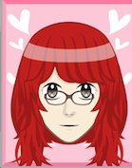
The profile will include a name, which may be a pseudonym (made up name) and details about the person. It is up to the user how much they reveal and whether they are truthful or not.
A profile can also contain a picture of the person, this could be a real photograph or an avatar

Slide 7
INSTANT MESSAGING
Instant messaging is a way to exchange messages instantly between two or more users.
Usually online software is used to make connections between the users and provide an environment where they can chat, share files such as images, and use emoticons.

Slide 8
CLIENT AND SERVER ROLES IN
INSTANT MESSAGING
The chat program is processed on the user’s computer (the CLIENT).
Each person chatting holds a local copy on their computer. Other processing may be carried out on the SERVER, for example when users are logging in.

Slide 9

Model Question 1
There are advantages and disadvantages to social
Networking and instant messaging. (6 marks)
Drag and Drop answers into correct place in the table:
HINT:
This will be a drag and drop on the computer so read the statements carefully before moving the answers!

Slide 10
Model Question 1
ADVANTAGES | DISADVANTAGES
Cheap to use
Needs internet access
Viruses could spread
May lead to misunderstandings
Able to communicate in real time
Able to do video conferencing/sharing/ gaming

Slide 11
Model Answer 1
ADVANTAGES | DISADVANTAGES
Able to communicate in real time
Viruses could spread
Cheap to use
May lead to misunderstandings
Able to do video conferencing/sharing/ gaming
Needs internet access

Slide 12
Model Question 2
Explain how instant messaging is different from email as a method of communication. (2 marks)
HINT:
You should explain how each work and compare them.

Slide 13
Model Answer 2
Instant messaging requires those involved to be connected at the same time, using email does not. The messages are sent instantly across the internet, whereas in email they sit on the server until they are accessed.

