Slide 1

ONLINE DOCUMENTS
FILE COMPRESSION

Slide 2
File compression makes files SMALLER so that they take up less space in computer memory.
Compression is also knows as ‘zipping’ and is done using an ALGORITHM.

Slide 3
WHAT IS AN ALGORITHM?
You use code to tell a computer what to do. Before you write code you need an algorithm.
An algorithm is a list of rules to follow in order to solve a problem.
Algorithms need to have their steps in the right order.
Think about an algorithm for getting dressed in the morning. What if you put on your coat before your jumper? Your jumper would be on top of your coat and that would be silly!
When you write an algorithm the order of the instructions is very important.

Slide 4
FILE EXTENSIONS
File extensions for compressed files include:
.zip
.rar
.7z
.dmg

Slide 5
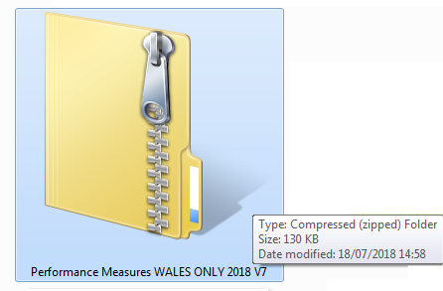
FILE EXTENSIONS
Sample of compressed file using WINZIP

Slide 6
COMPRESSION ALGORITHM
Each file extension is created using a different compression algorithm.
Therefore, the user compressing and expanding the file needs to use the same program.
(e.g., win zip)

Slide 7

FILE COMPRESSION
Advantages
Saving memory space on computers e.g., web server.
Files will upload and download more quickly.
Files will better fit restrictions such as the attachment limit on email.

Slide 8
INDEX
When files are compressed, the last item in the compressed file is an INDEX.
It contains the information needed to expand the files to their original size.

Slide 9
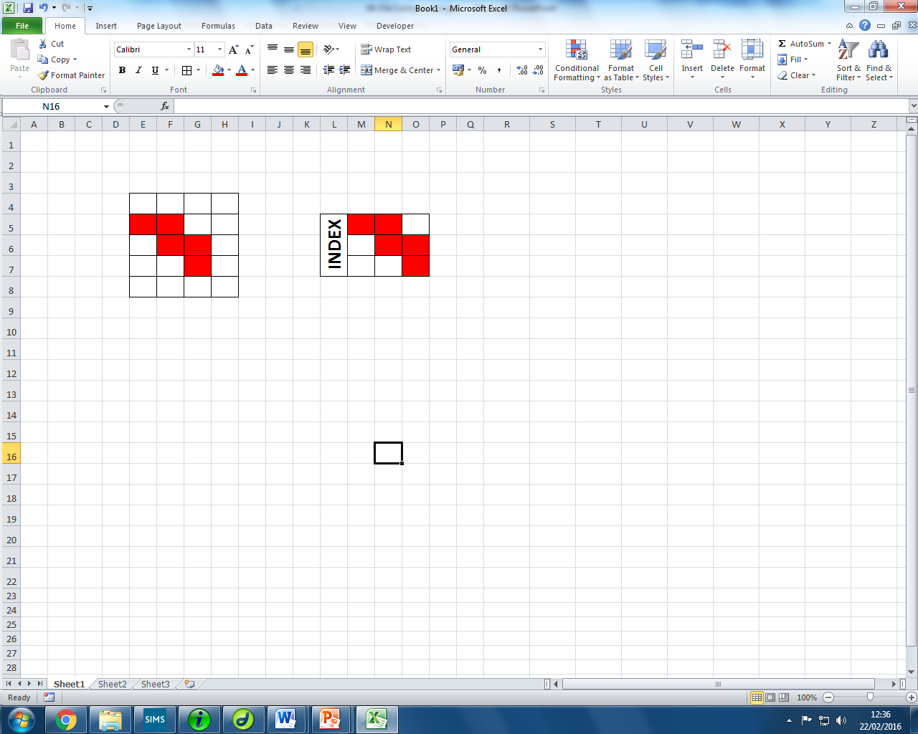
COMPRESSION DIAGRAM
INDEX
APPLY ALGORITHM
COMPRESSED FILE
ORIGINAL FILE
USE INDEX TO EXPAND
COMPRESSED FILE
ORIGINAL FILE

Slide 10
DESCRIBING THE PROCESS
The compression software takes the
and This create an INDEX file which
becomes part of the
When the is expanded the program
Doing this recreates the
ORIGINAL FILE
APPLIES AN ALGORITHM.
COMPRESSED FILE.
COMPRESSED FILE
USES INDEX TO EXPAND IT.
ORIGINAL FILE.

Slide 11

Model Question 1
Describe how an algorithm and index are used in file compression. (2 marks)
HINT:
Remember the diagram? Explain what happens when a file is compressed then expanded.

Slide 12
Model Answer 1
An algorithm is used in compression to make the file smaller. An index file is included when an algorithm is used and is part of the compressed file. When the file is expanded, the index holds the information to recreate the original file.

Slide 13
Model Question 2
Sally is sending an email. She would like to attach three files which total 27 Mb. Her email’s limit is 25 Mb but she does not want to send them separately. (2 marks)
Explain how file compression would help.

Slide 14
Model Answer 2
Compression will allow all of the files to be compressed into one file and makes the file smaller, allowing Sally to send it by email

Slide 15
Model Question 3
Describe the process of compressing and expanding the files. (2 marks)
HINT: Think carefully about all the information the question is asking for!

Slide 16
Model Answer 3
To compress a file, an algorithm is used and the last item of the file is an index.
To expand a file, the index allows the files to return to their original size.

