Slide 1

ONLINE ADVERTISING
WHAT IS ONLINE ADVERTISING?
http://www.knowitallninja.com/lesson/online-advertising/

Slide 2
Online Advertising is designed to capture and hold the attention of a user to promote a product or service.
There are several methods which can be used.

Slide 3
SEARCH ENGINE PAID FOR LINKS
This involves a search engine company (e.g., Google) charging fees for the inclusion of a website (e.g., Funky Pigeon) in their results pages.
Also known as sponsored listings, paid inclusion products are provided by most search engine companies either in the main results area, or as a separately identified advertising area.

Slide 4
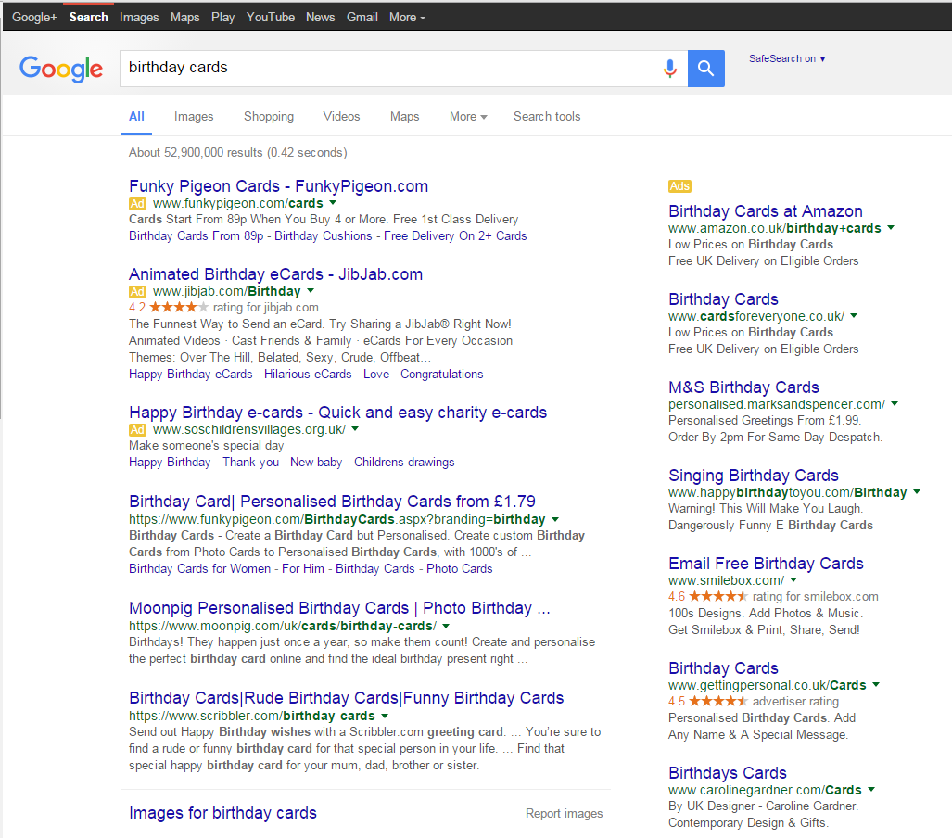
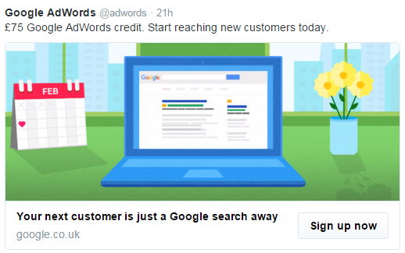
SEARCH ENGINE PAID FOR LINKS
EXAMPLE
This shows a search engine results page with sponsored (paid for) links appearing at the top and to the right of the main screen.

Slide 5

SEARCH ENGINE PAID FOR LINKS
Advantages/Disadvantages
Best deals may not be at the top
Featured advertising may be filtered e.g., in school
Quick to find what you are looking for
X
X

Slide 6
2. PAY-PER-CLICK ADVERTISING
A web page will host an advert for another organisation. If a user clicks on the advert, they are directed to the advertiser’s website.
The host will receive payment for each user who clicks on the advert.

Slide 7
AFFILIATE MODEL (advertising method)
This is known as an affiliate model. Often these are banner or ‘pop-up’ adverts and can be effective in catching users’ attention but can also be annoying!

Slide 8
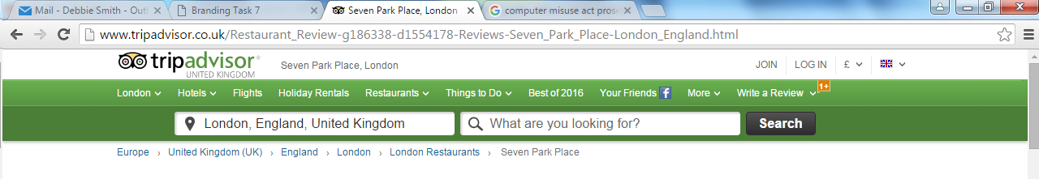
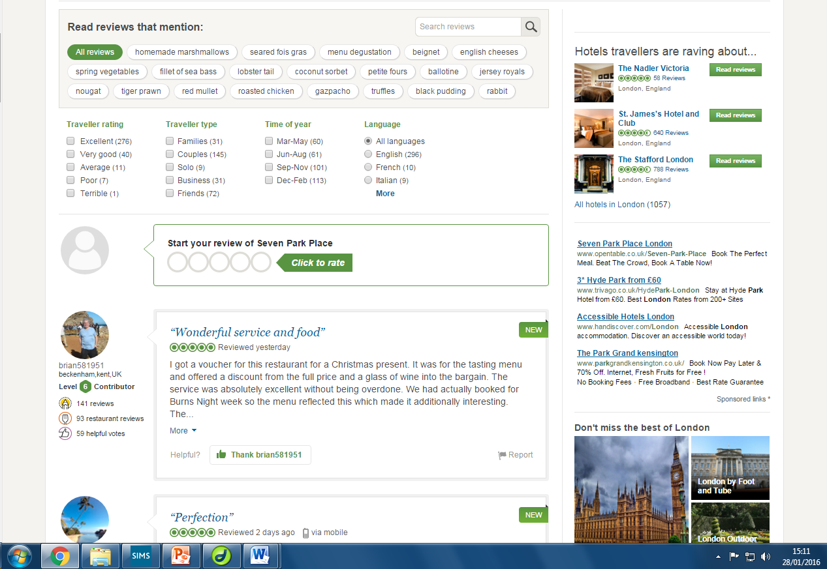
PAY-PER-CLICK ADVERTISING EXAMPLE
This shows a web page featuring sponsored links (pay for click).
In this case Trip Advisor are the host as they are advertising hotels.
These hotels are the advertisers and will pay a fee to Trip Advisor for this service.

Slide 9
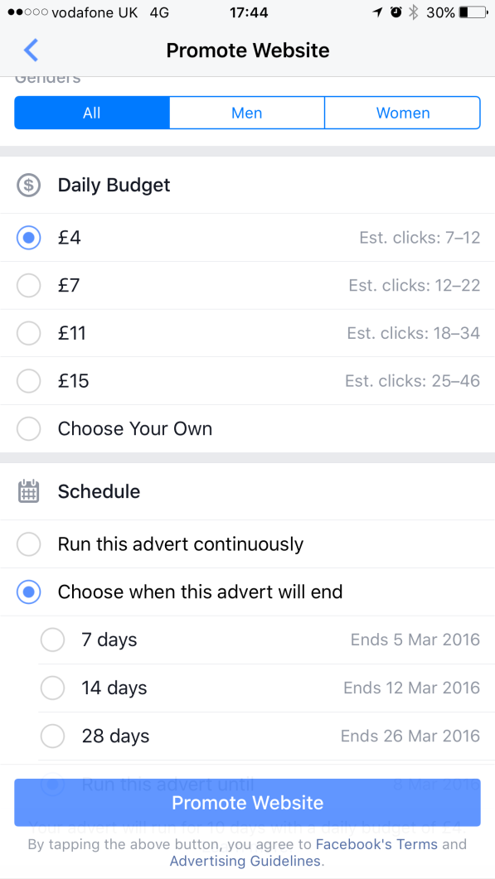
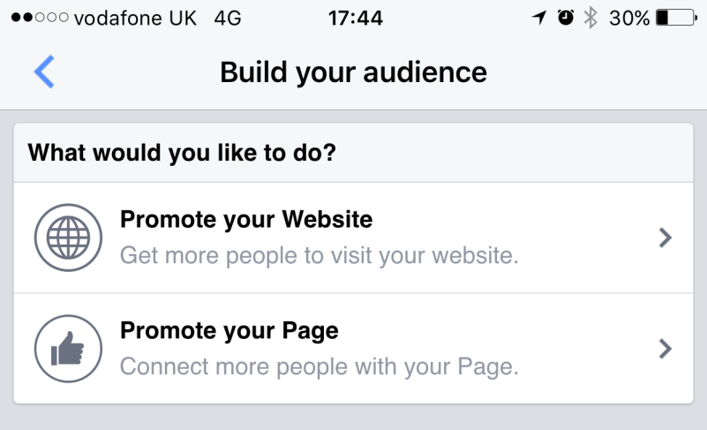
PAID FOR ADVERTISING - FACEBOOK
You can pay Facebook to promote your web/site page it will then appear on newsfeeds

Slide 10
PAY-PER-CLICK ADVERTISING
Advantages/Disadvantages
Pop ups can be annoying
Often videos/animations and can distract the user from what they are doing
Can be linked to websites e.g., horse riding competition site may advertise saddles
X
X

